Slide 1

Applied Data Science Capstone
The Battle of Neighborhoods: Where to Open an Italian Restaurant in NYC?
By Vadim Kropanev

Slide 2
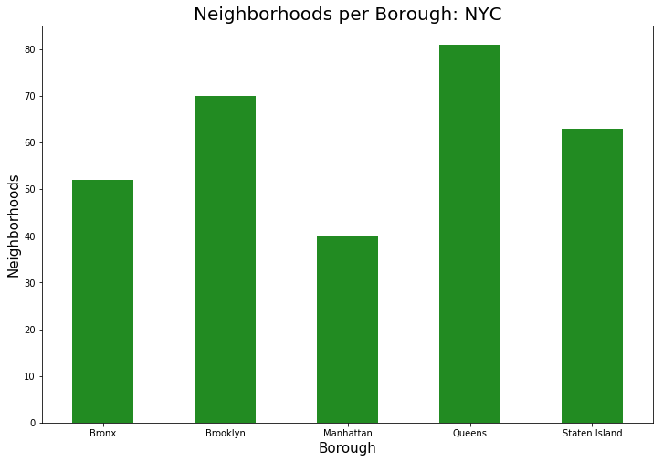

Slide 3
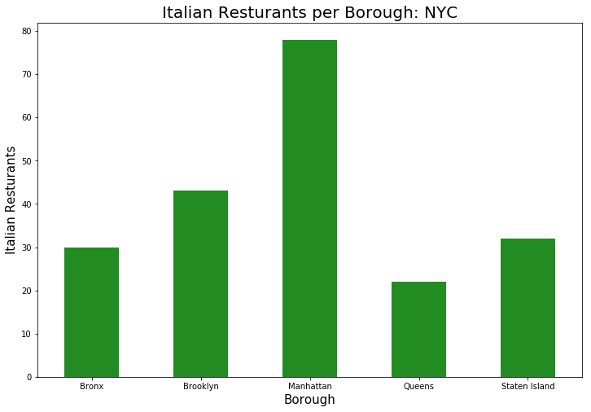

Slide 4
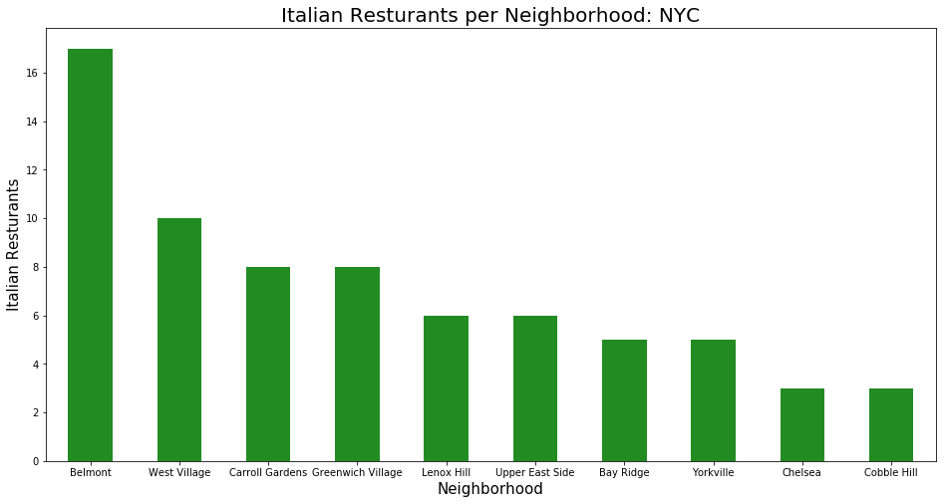

Slide 5
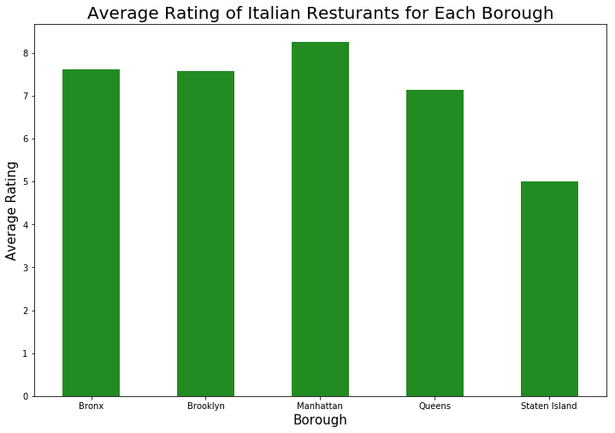

Slide 6
